Slide 1
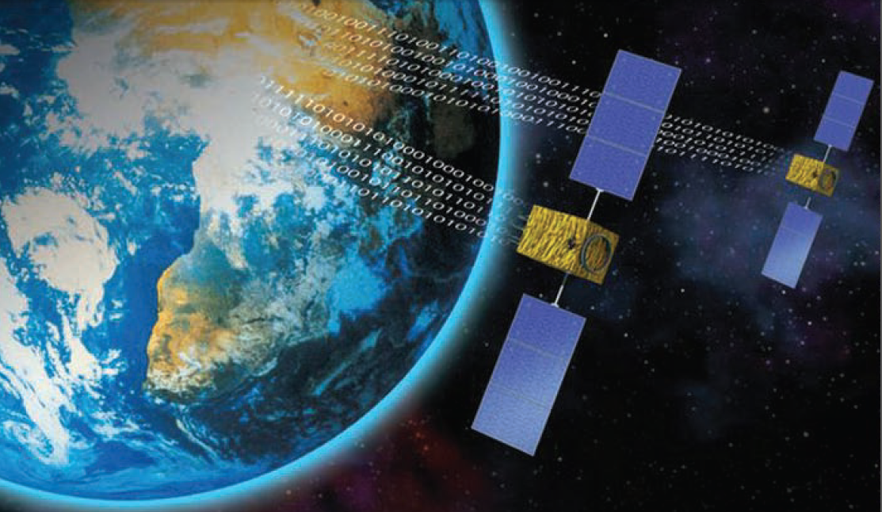
Satellite Communication
By:
Md. Omar Kaushru
Id: 1401020012
Batch: Spring 14
Semester : Summer 15
Course title: Computer Networks
Faculty: Mr. Arif Mahmud

Slide 2
Discussion Area
Birth of Satellite Communications
Architecture
Applications
Problems
Future prospect

Slide 3
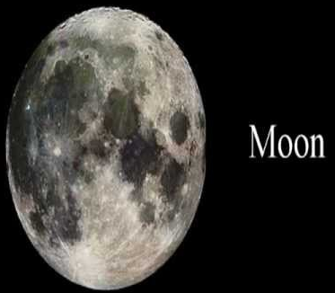
Birth of Satellite Communications
Before going to the discussion about the birth of satellite communication, let us know about the satellite.
A satellite is a moon, planet or a machine that orbits a star or planet. Such as, Earth itself a satellite because it orbits the sun. As like as the moon also a satellite because it orbits Earth.
Generally, the word "satellite" refers to a machine that is launched into space and moves around Earth or another body in the space.
The Second World War moved the expansion of two very different technologies missiles and microwaves. The skill eventually gained in the combined use of these two techniques opened up the era of satellite communications.

Slide 4
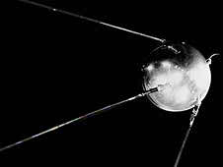
Figure: The first satellite in 1959 “NASA's Explorer 6”. Credits: NASA.

Slide 5
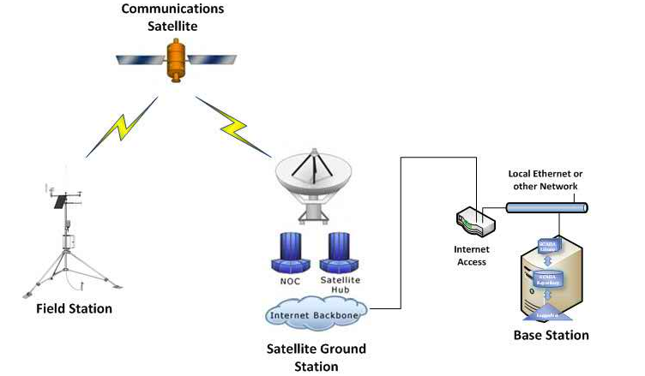
Let us know, what is actually mean by the satellite communication.
A satellite communication is a communication that involves the use of an active or passive satellite for extend the range of a communications, radio, television, or other transmitter by returning signals to earth from an orbiting satellite. In this communication the satellites pass information from a source to a receiver.
Figure: Satellite Communication.

Slide 6
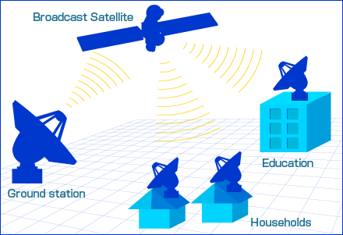
Architecture of Satellite Communication
Transmission Media in satellite communication systems operate in two configurations: (a) mesh; and (b) star. In mesh configuration, two satellite terminals communicate directly with each other. In star configuration, there will be a central station (called a hub), and remote stations communicate via the hub.

Slide 7
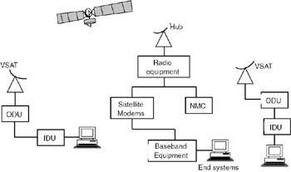
The architecture of a satellite communication system is shown in Figure. The system consists of two segments:
1. Space segment
2 Ground segment
Figure: architecture of a satellite communication system.
The space segment of the satellite has three main systems: (a) fuel system; (b) satellite and telemetry control system; and (c) transponders.

Slide 8
The fuel system is responsible for making the satellite run for years.
The satellite and telemetry control system is used for sending commands to the satellite as well as for sending the status of onboard systems to the ground stations.
The transponder needs to do the necessary frequency translation.
Figure: Payload organization: (a) transparent and (b) regenerative.

Slide 9
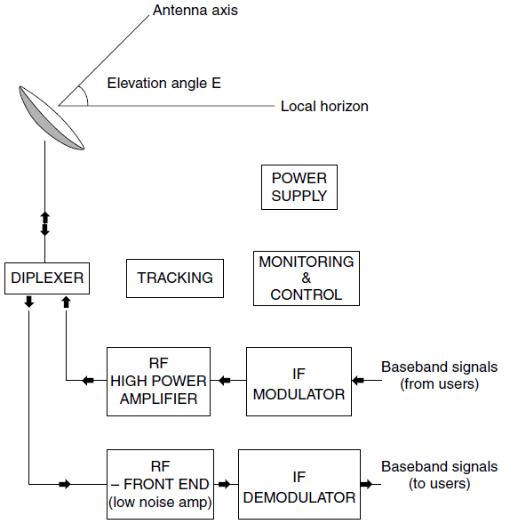
The ground segment consists of a number of Earth stations.
In a star configuration network, there will be a central station called the hub and a number of remote stations.
The central station consists of a large antenna (4.5 meters to 11 meters) along with all associated electronics to handle a large number of VSATs.
Each remote station will have a very small aperture terminal (VSAT), an antenna of about 0.5 meter to 1.5 meters.
Figure: The organization of an earth station. RF¼ radio frequency, IF¼ intermediate frequency.

Slide 10
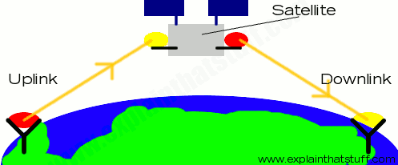
Frequencies of Operation: The three widely used frequency bands in satellite communication systems are C band, Ku band, and Ka band.
The various bands of operation are:
C band: Uplink frequency band 6GHz (5.925 to 6.425 GHz).
Downlink frequency band: 4GHz (3.7 to 4.2 GHz).
Ku band: Uplink frequency band 14GHz (13.95 to 14.5 GHz).
Downlink frequency band: 11/12GHz (10.7-11.25 GHz, 12.2-12.75 GHz).
Figure: Uplink & Downlink of a Satellite.

Slide 11
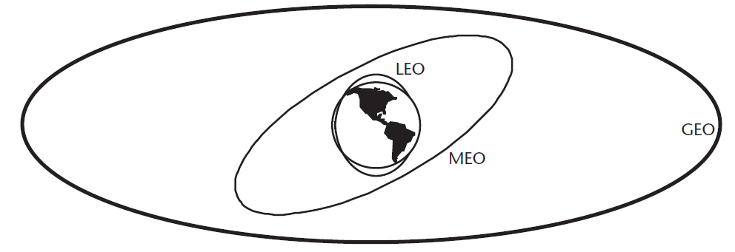
Applications of Satellite Communication
In general, satellites have a natural broadcast feature and it can cover large areas. They are useful for TV and Radio broadcast, as well as for (reliable) data multicast (content distribution). Such as web content can be distributed to ISPs and caches at the Internet edge.
Similarly, satellites are useful for building wide area networks for distributed company institution branches (VSAT networks).
Figure: The three most popular orbits for communication satellites.

Slide 12
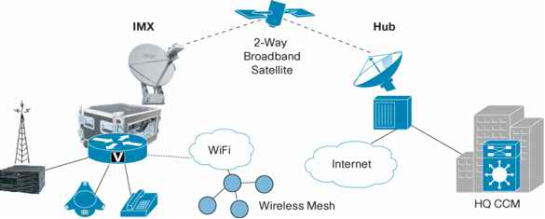
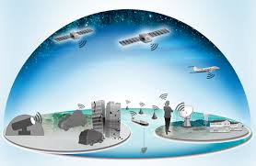
A satellite has large number of applications. We can summarize them by their types as follows:
Satellite Application Types
Broadcast and Multicast of Digital Content.
Voice and Telephony Networks.
Data Communications and the Internet.
Mobile and Personal Communications.

Slide 13
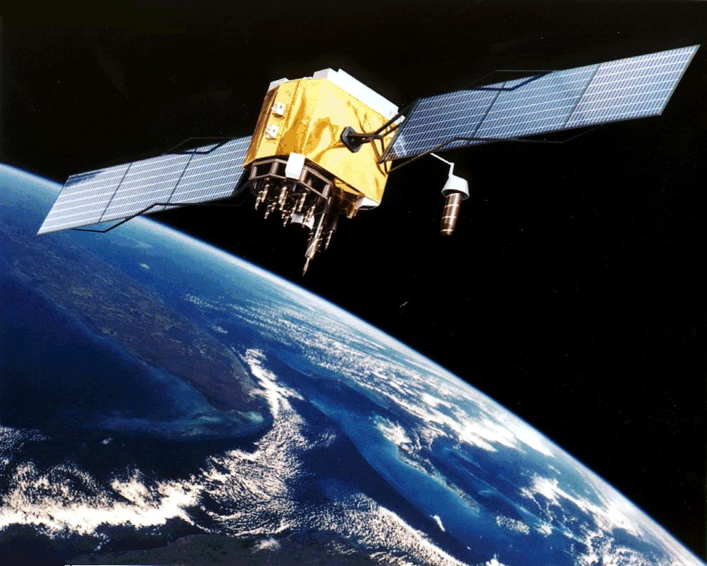
Problems of Satellite Communication
The Satellite Communication also has some problems that can be summarized as follows:
Satellites launching into orbit are very expensive.
Among the Satellite in position the communication path between the terrestrial transmitter and receiver is relatively 75000 km long.
Satellite communication has a larger propagation delay than in terrestrial communication.
The time delay reduces the effectiveness of satellite in data transmission and long file transfer, which passed through the satellites.
Overloading of available bandwidth because of low antenna gains is occurred.
High atmosphere losses more than 30 GHz limit the carrier frequency.
Figure: A satellite orbiting the earth.

Slide 14
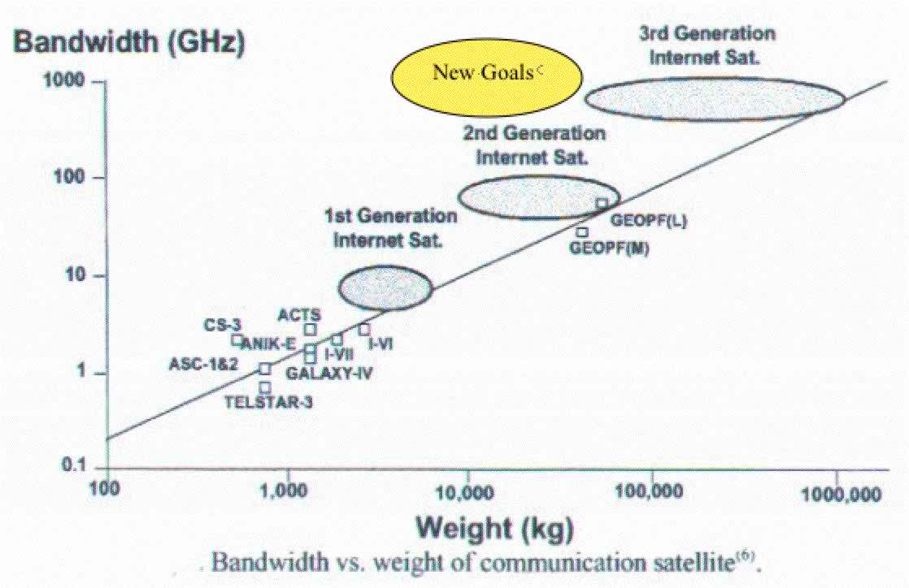
Future prospect of Satellite Communication
New Goals for Future Satellite Communications Development:
Improvement of 10 to 100 times more serviceable radio frequency.
Allow the beginning of new forms of client friendly and highly compact micro-terminals.
Build system economies that would totally decrease the cost of global telecommunications networks, broadcast and mobile services, and international Tele-education, Tele-health, Tele-safety and disaster warning systems.
Figure: New Goals for Future Satellite Communications Development.

Slide 15

Thanks to all!

